Slide 1

MCU TNC Design
Kaleb Leon, Kobe Keopraseuth, David Cain
Design 1
FINAL PRESENTATION

Slide 2


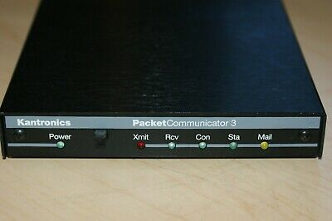
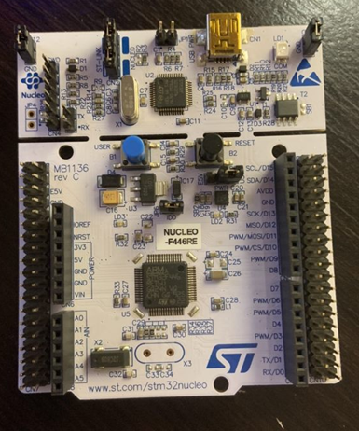
Project Overview
Design a compact efficient Terminal Node Controller using the STM32 platform
Radio
Radio

Slide 3
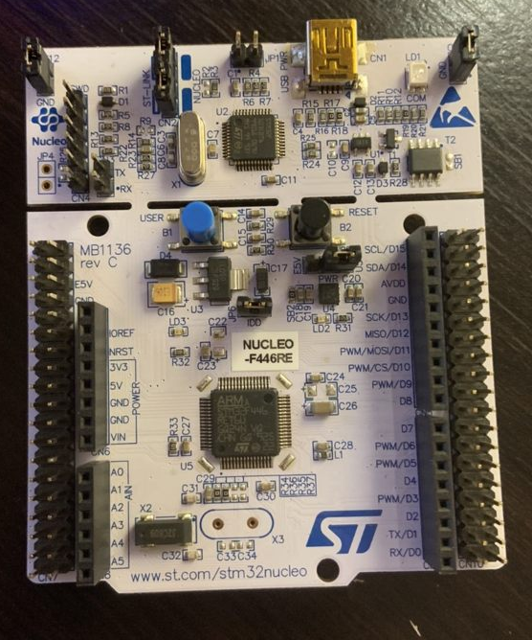
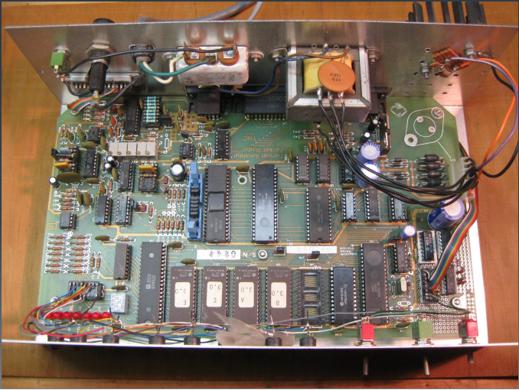
STM32 TNC
TAPR TNC-1
Full Setup: $53
Full Setup: ~ $140
VS.
Size: 2’’x2’’
Logic:
Coded in C without much external hardware of chips
Hardware:
Nucleo STM32 Board
Documentation:
Easier to document code ( also easier to find and reuse)
Nucleo Board is proprietary hardware and well documented and tested
Size: 1’x6’’
Logic:
Data formatted mostly by analog logic chips
Hardware:
Many circuits in addition to many integrated chips
Documentation:
Not well documented
hard to find info to repair if something is wrong
many different designs so only people who make these know how to fix them

Slide 4
Design Process

Slide 5
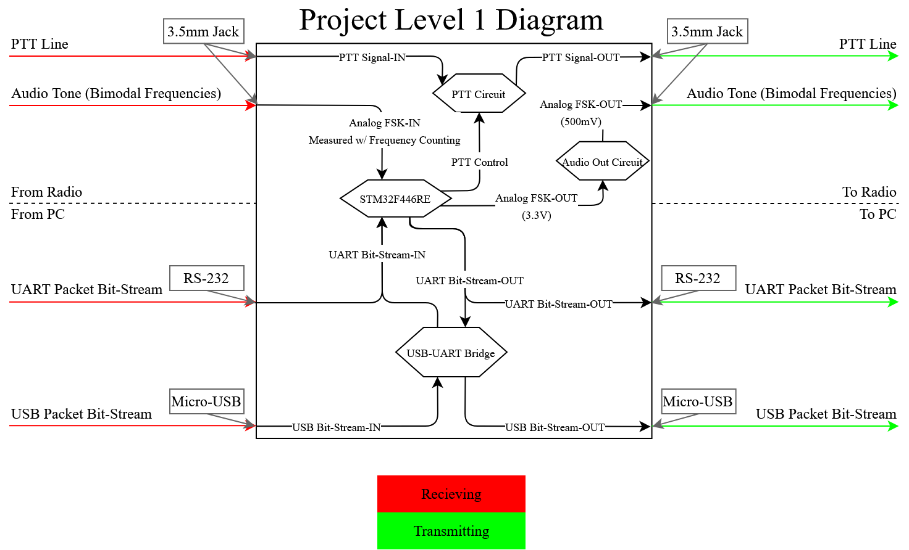
Scope of Work & Functional Block Diagram
To Implement and design a Terminal node Controller using the STM32 platform that is capable receiving and transmitting data packets, serving as a modem between a PC and a radio.

Slide 6
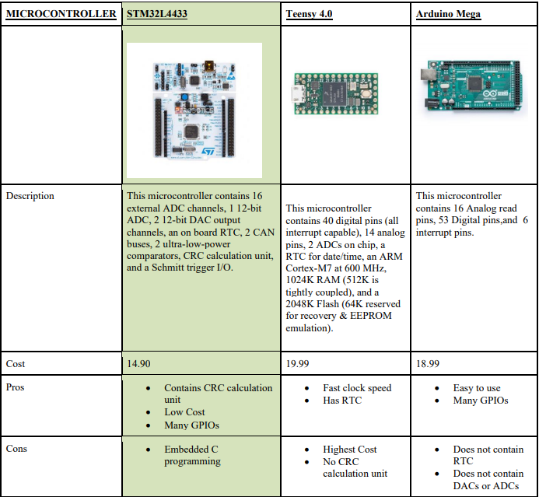
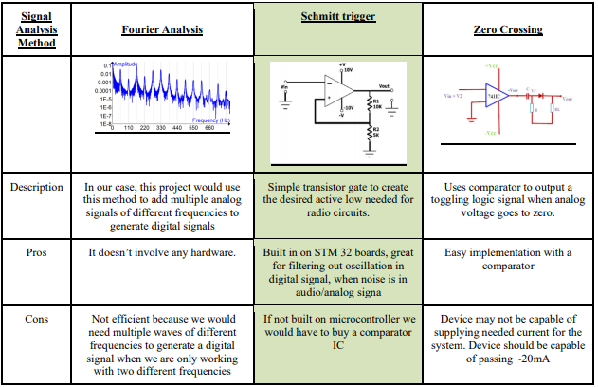
Alternatives and Tradeoffs

Slide 7
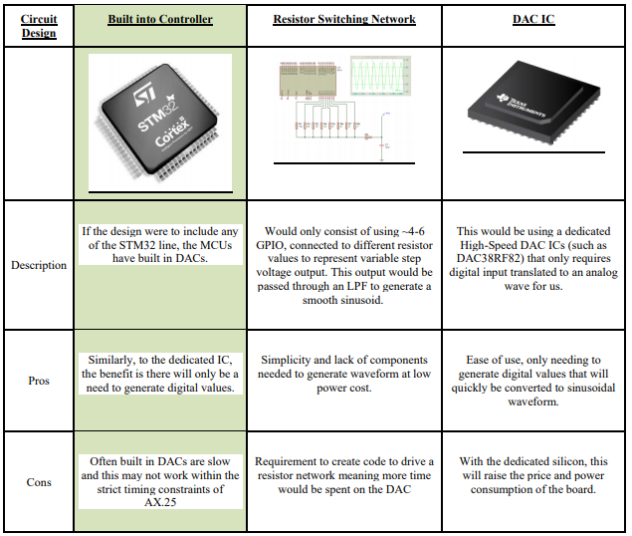
Alternatives and Tradeoffs

Slide 8
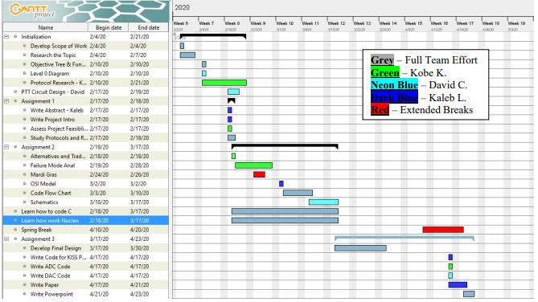
Feasibility Analysis

Slide 9
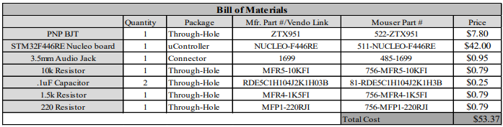
Feasibility Analysis

Slide 10
Software Flow Breakdown

Slide 11
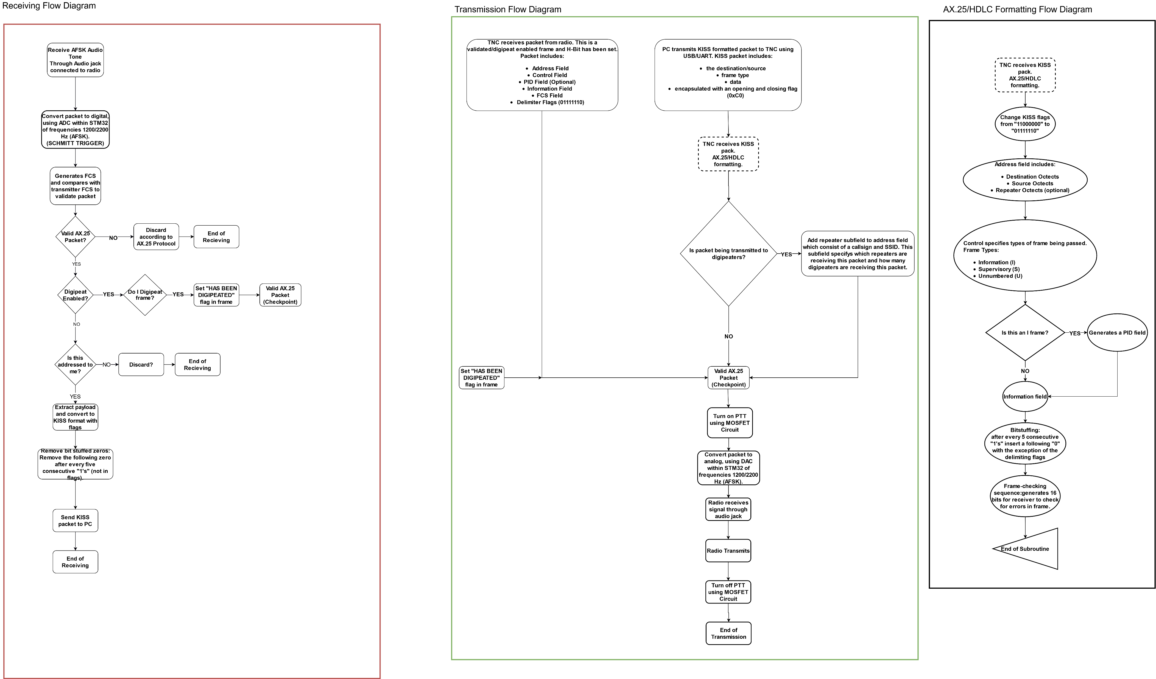
KISS Packet to AX.25
VALIDATION/TESTING:
Create our own packets of which we know what the data section says (example in HEX “Hello world”). This HEX packet is sent to the TNC over the USB. It is then picked apart for its data section. This data section is then translated back into HEX then Ascii and outputted to serial. We monitor this serial to see if it is outputting the correct data.

Slide 12
Receiving Mode
Analog to Digital
In this mode the TNC will be receiving and measuring the frequency of the audio tones from the radio.
If a tone matches 2200/1200 Hz (5% tolerance) then a 1/0 will be stored in an array, respectively.
Once the conversion is finished, the STM32 will generate a CRC value to compare with FCS section of packet. If it does not match, then discard packet.
If it does match, check if digipeat is enabled. If so, turn on PTT and got into transmitting mode.
If digipeat is not enabled, then check if packet’s address matches the TNC’s address, if not discard.
Convert packet stored in array to KISS format.
Transmit packet to PC through USB or UART.

Slide 13
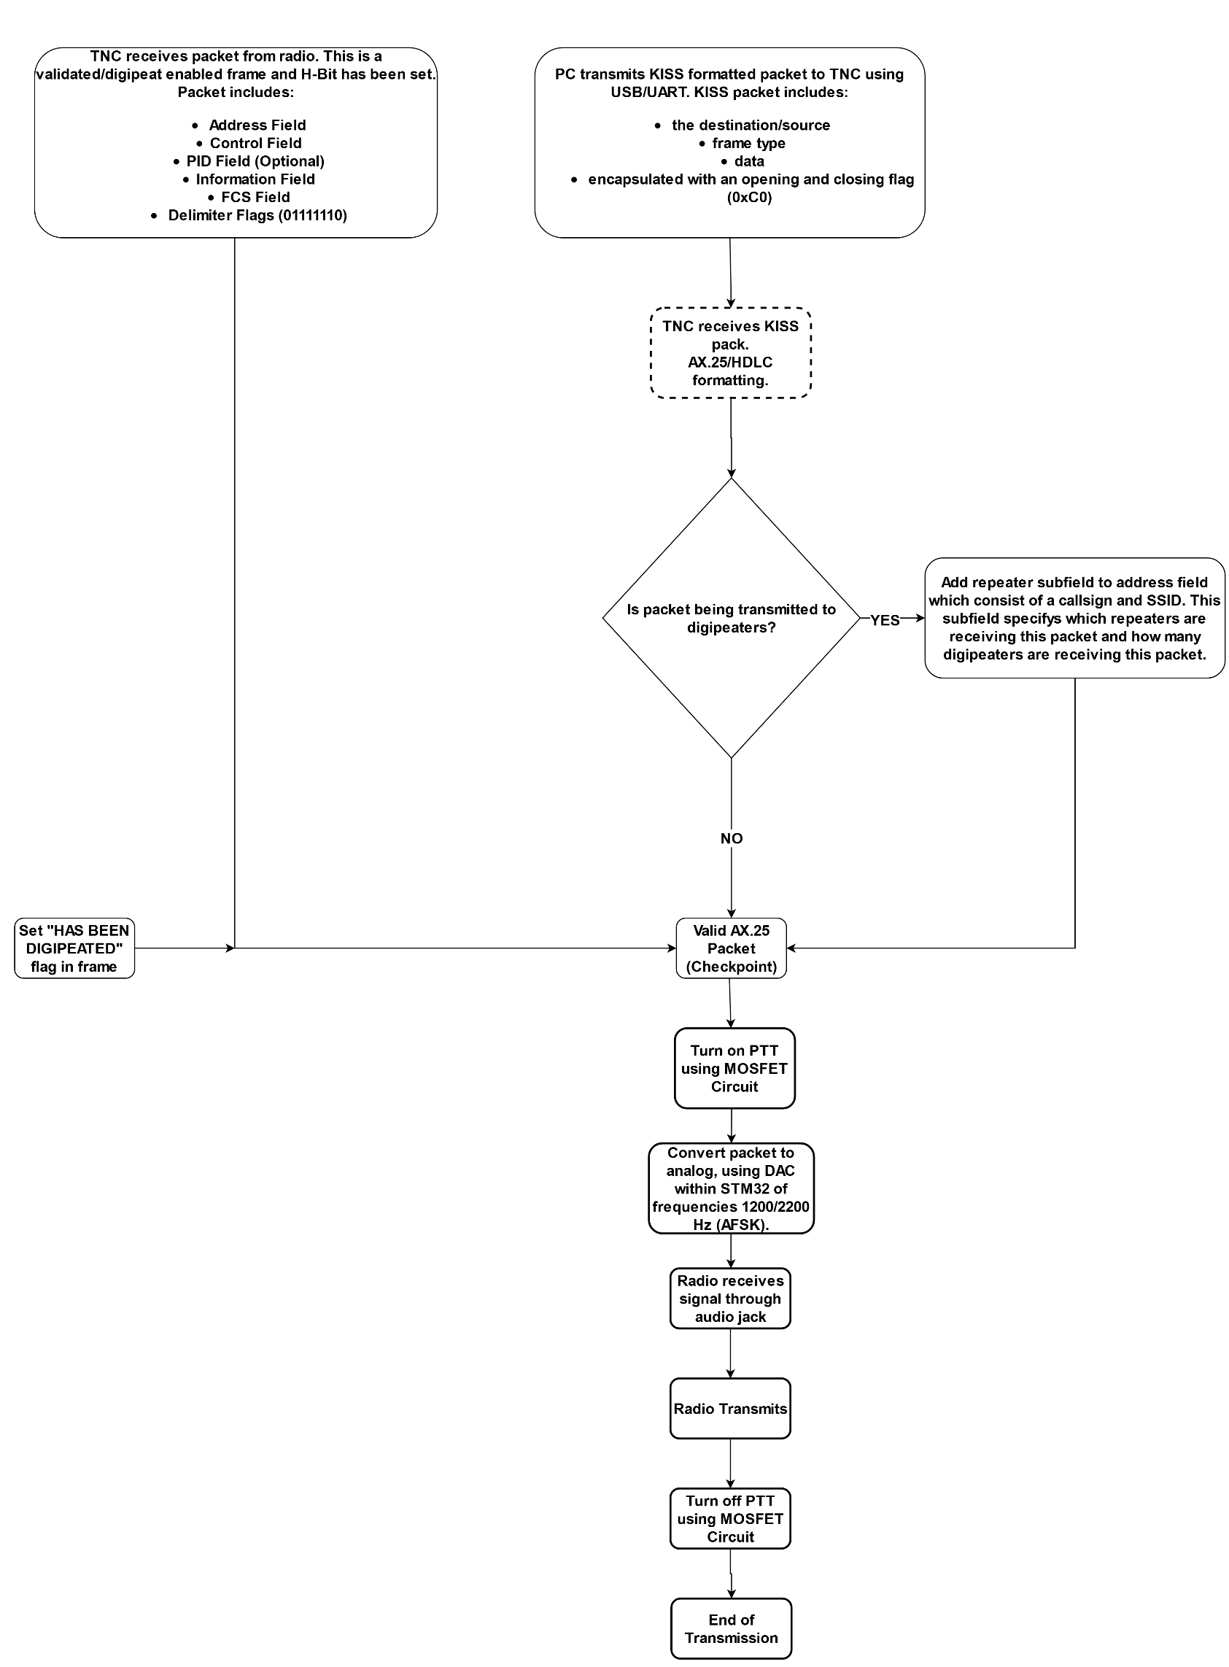
Transmitting Mode
Digital to Analog
In this mode the TNC will be producing audio tones to be received by the radio.
The audio output will be a binary AFSK representation of the packet being sent
The waveform values for 1200Hz/2200Hz are stored as an array to be converted using the onboard DAC.
Before audio is being produced, the TNC will pull the PTT line low, indicating to the radio to begin receiving.
Once the AFSK waveform has been sent to the radio, the PTT line will be released, putting the TNC back in to receiving mode.

Slide 14
Modulation and Demodulation Validation
A short binary bitstream is hardcoded to be sent to the DAC
The microcontroller saves this bit stream to a memory location that is reference and then parsed through as it is sent to the DAC
The DAC creates an audio signal that is sent over wire back into the TNC where it is demodulated at the ADC code block
If the data returns the same as what was sent out the process is valid.

Slide 15
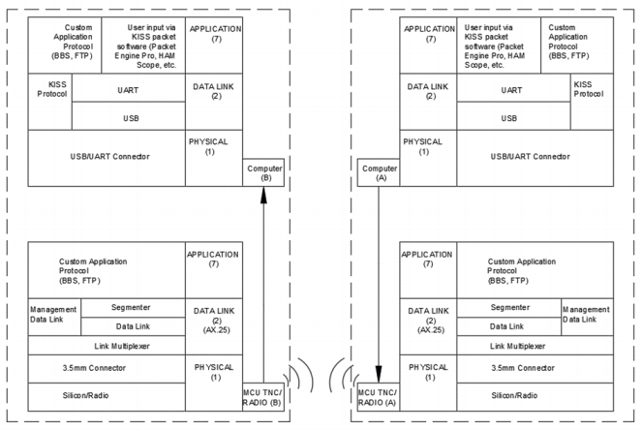
OSI Layered Communication Model

Slide 16
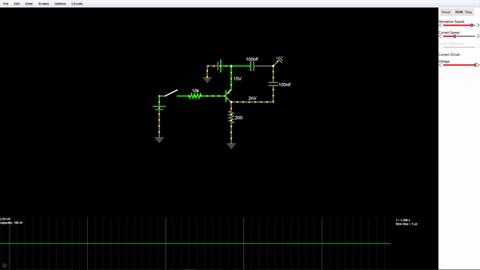
Hardware Validation and Simulation
BJT Push to Talk Circuit

Slide 17
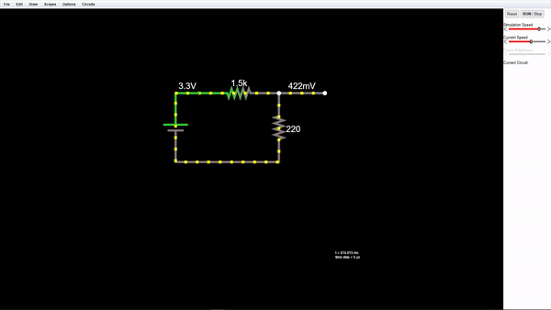
Hardware Validation and Simulation
Voltage Divider to Control Voltage Output

Slide 18
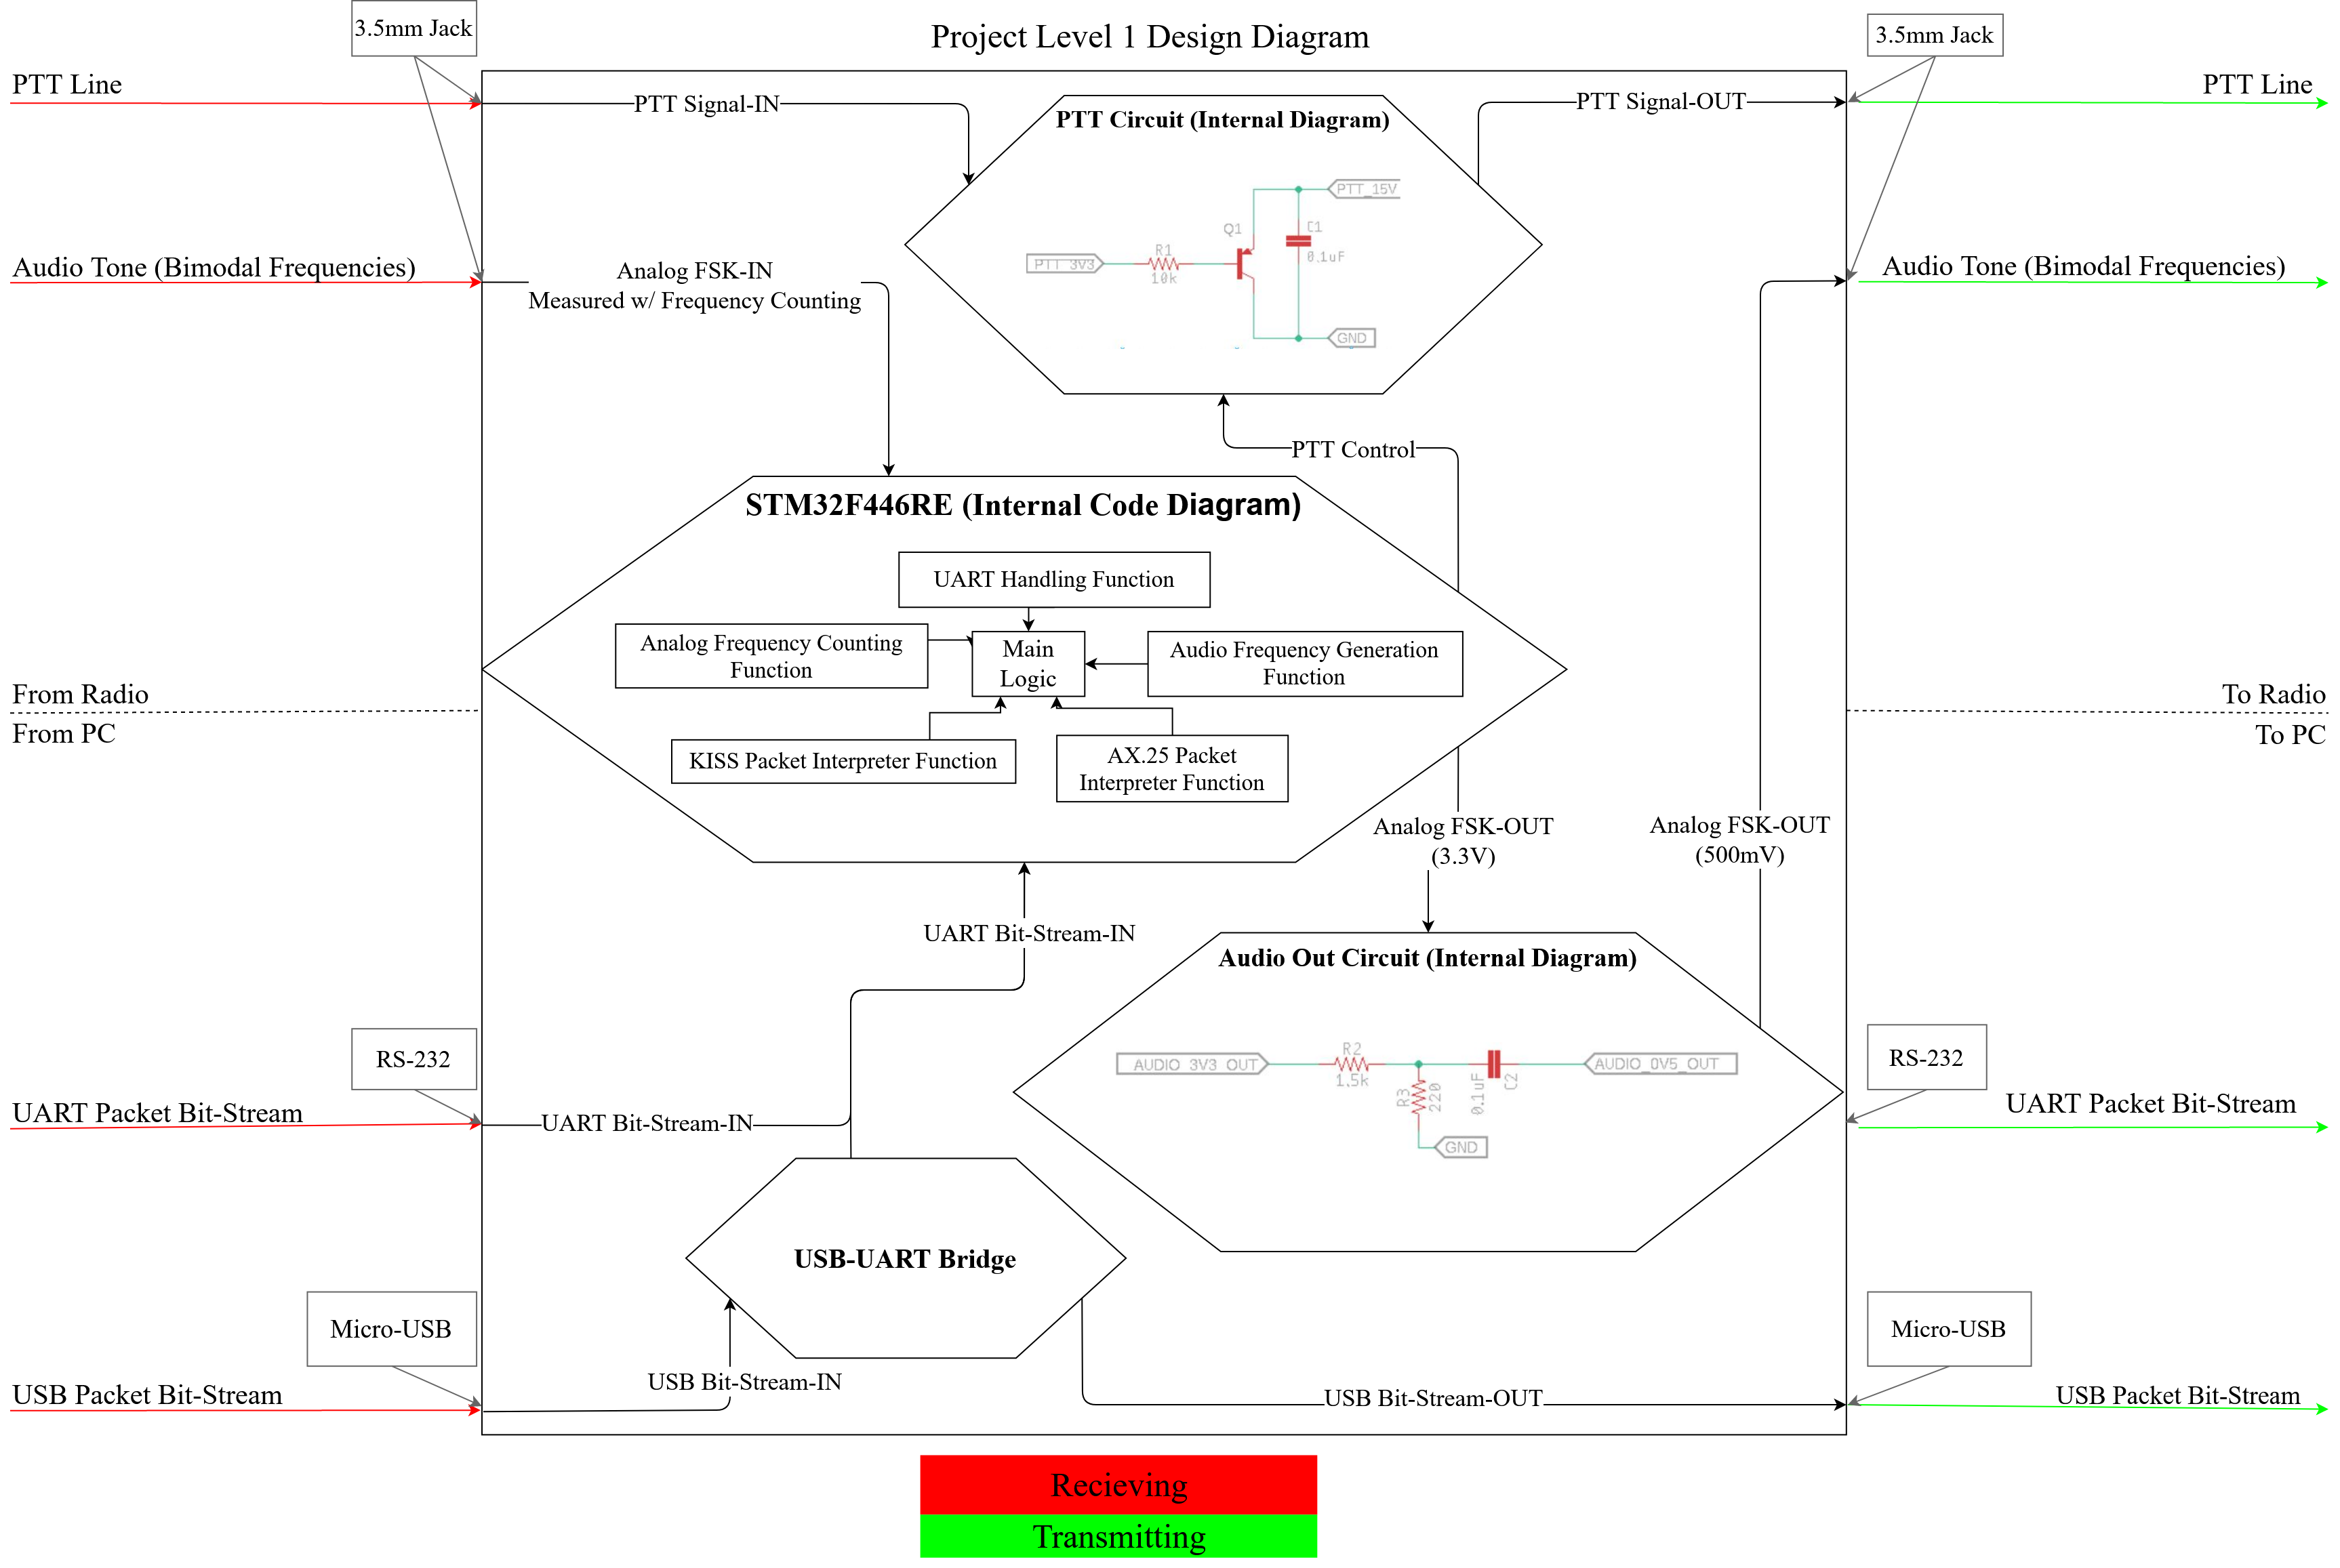
Final Design: Level 1 Design Diagram

Slide 19
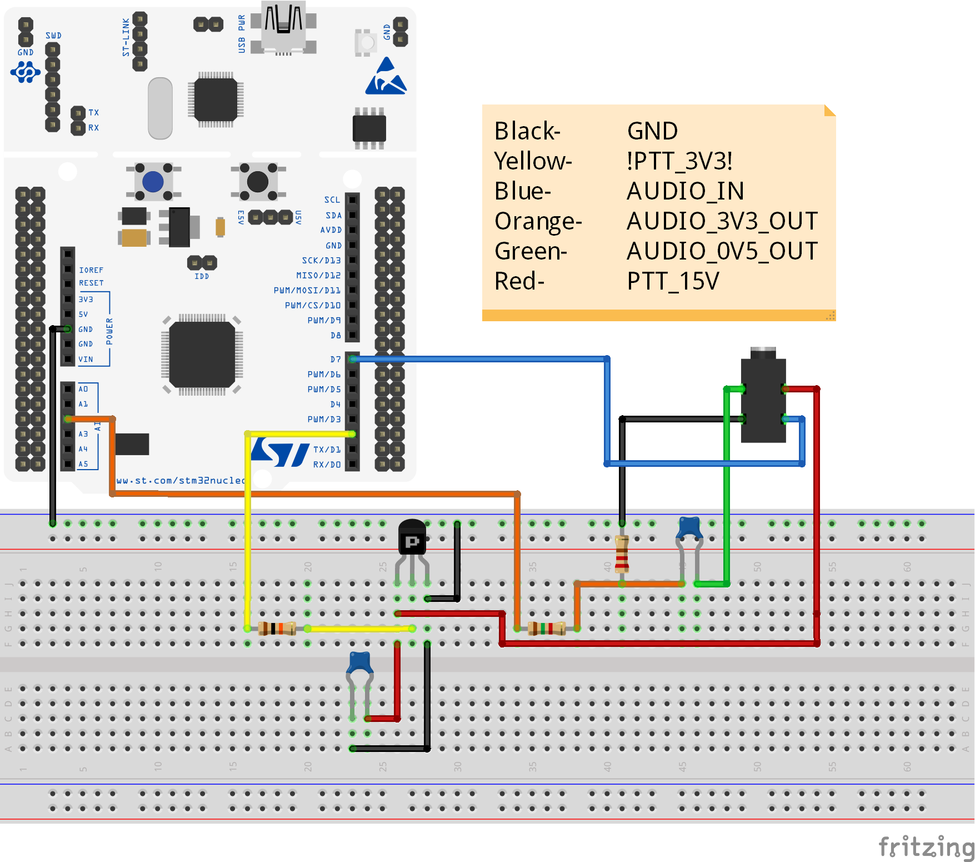
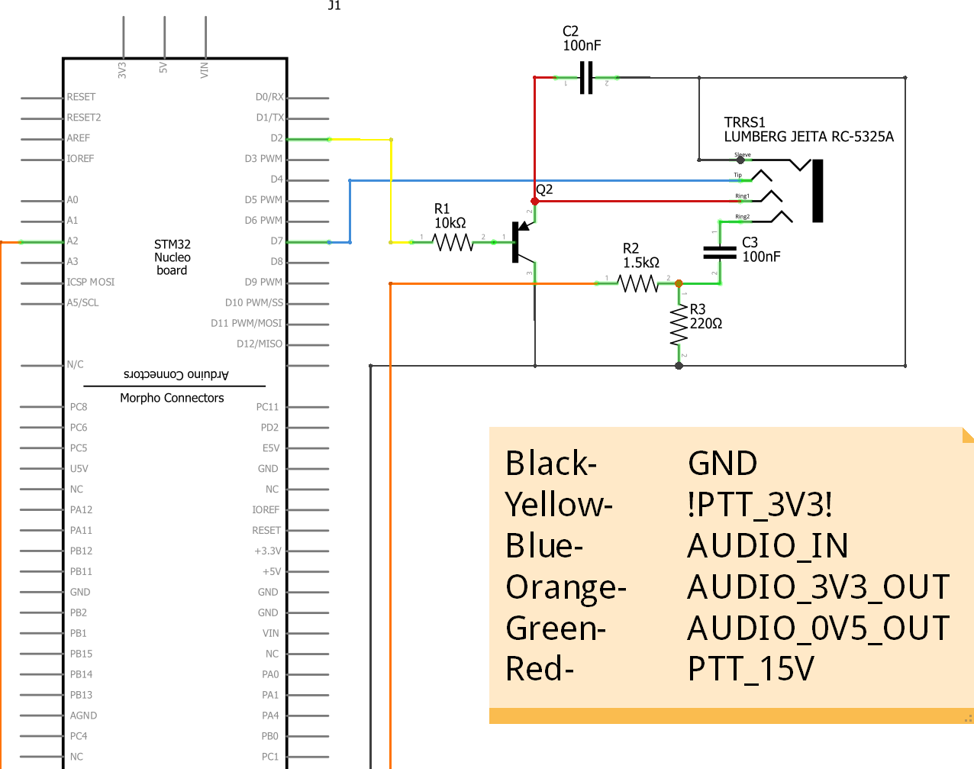
Modular Wring Schematic

Slide 20
Acknowledgements
Project Mentors:
Mr. Nolan Edwards
Mr. Rizwan Merchant
Mr. Nick Pugh
Mr. James Palmer
Special Thanks:
CAPE Team
Pelican Engineering

Slide 21
Future Plans
Design PCB board for layout, for efficiency in space and power distribution.
Possibly wireless communication to other radios.
Design higher level software structures, such as APRS.
Design casing to protect components.

Slide 22
Lessons Learned
How to write a scholarly paper.
How to write in an embedded C environment.
A successful design requires considerations of extreme operation conditions.

Slide 23
Questions?

